Slide 1
Cardio-vascular 1
Pre-lecture notes:
PT7001 + PT4054
February 2025
c.chamberlin@londonmet.ac.uk

Slide 2
learning outcomes:
Why we need a cardiovascular system: diffusion vs convection
Body water compartments and the composition of blood Osmolarity and equilibria across membranes and capillaries, Pressures and flows in the CVS
The structure of the heart
The Cardiac Cycle
Myocardial action potential and contraction coupling

Slide 3
1. diffusion vs convection
Diffusion
Concentration gradient
Passive oxygen transport
Within Lungs and tissues
Fick’s 1st and 2nd laws
Notes:
Diffusion barrier of O2 = 30 micrometres (1/1000th of a mm)
1st Law = high to low
2nd Law = concentration gradient changes with time

Slide 4
Convection
Pressure gradient
Oxygen ‘bulk transport’ within the circulation
Avtive not passive and dependant upon the force production of the heart.
Notes:
PaO2 = 19.95 ml 100 ml⁻¹ blood
Normal male ‘delivery’ at rest = 997.5 ml min⁻¹

Slide 5
2. Body water compartments composition of blood Osmolarity and equilibria across membranes, capillaries

Slide 6
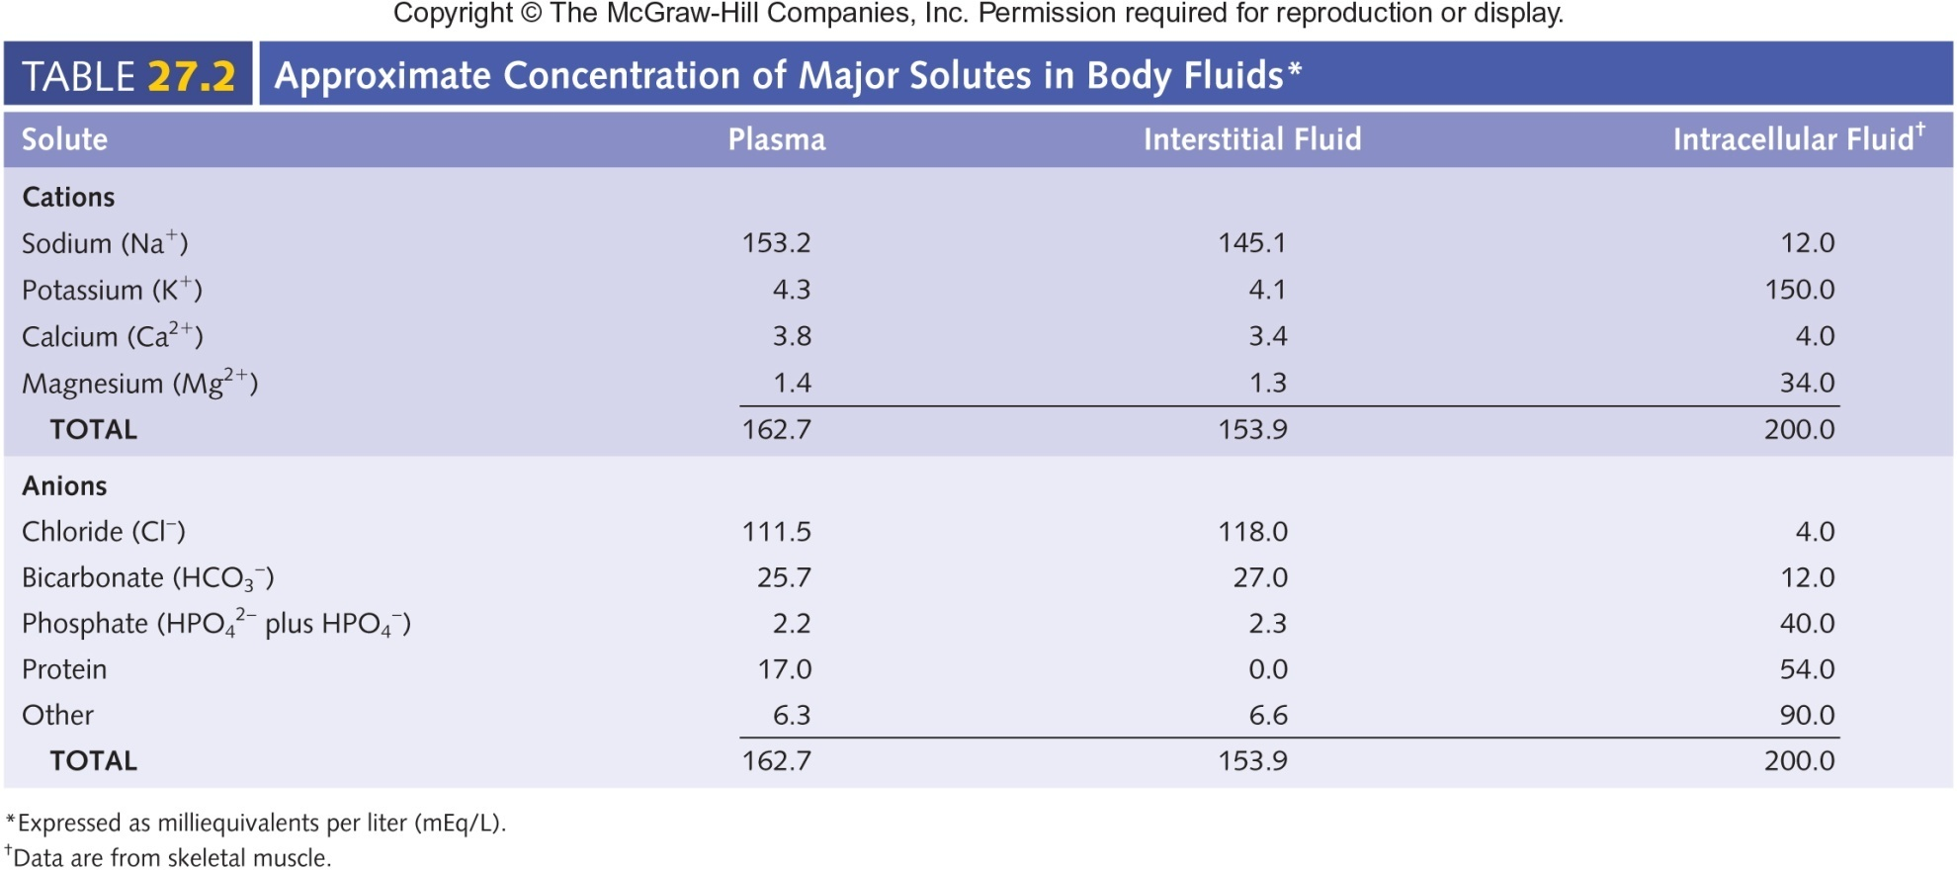
Body Fluid Compartments

Slide 7
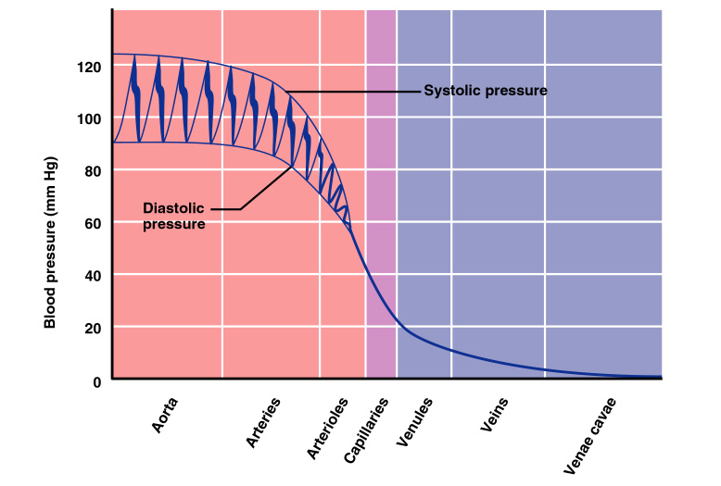
Arterial Blood Pressure
Blood pressure in the arteries is pulsatile
i.e. it rises as the left ventricle contracts and falls when it relaxes.
Blood velocity is inversely proportional to the cross-sectional area

Slide 8
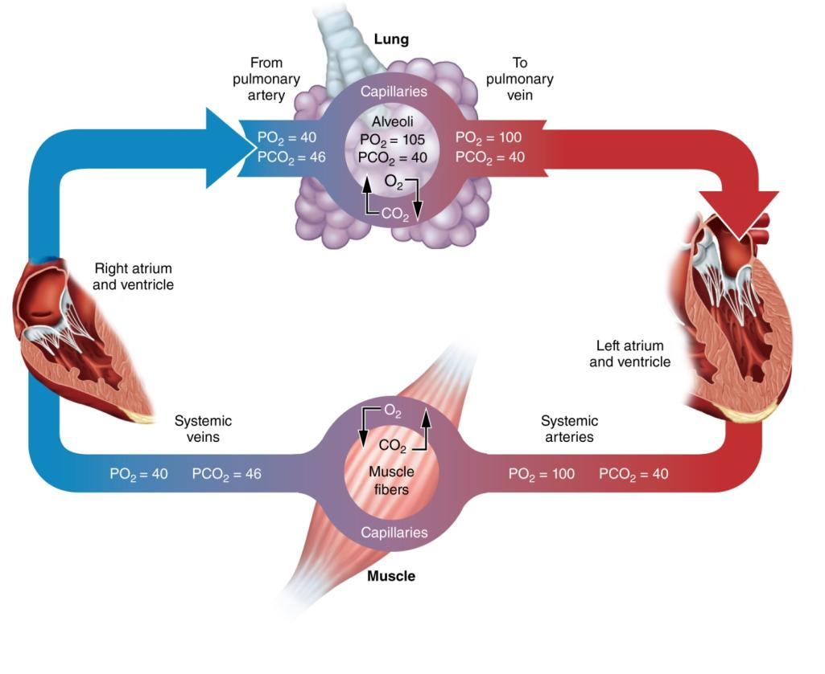

Slide 9
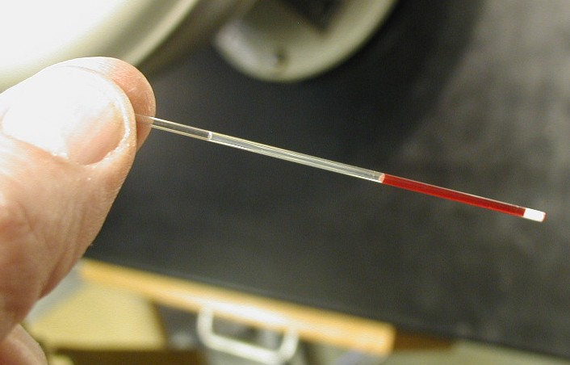
Haematocrit
47% (±5% for men)
42% (±5% for women)

Slide 10
Haemoglobin
1.39 ml O₂ g⁻¹ Hb = theoretical maximum oxygen capacity of 20.85 ml O₂ 100 ml⁻¹ blood at a ‘normal’ haemoglobin concentration of 15 g dl⁻¹
Male: 13.5–18.0
Female: 11.5–16.0.
Notes:
However, existence of abnormal forms of haemoglobin such as methaemoglobin and carboxyhaemoglobin, empirically this value seems to be closer to 1.31 ml O₂ g⁻¹ Hb

Slide 11
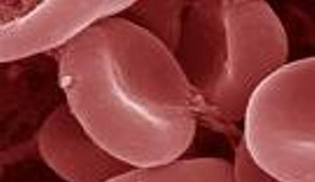
Red blood cells
Bi-concave discs that must deform as they pass through capillaries because they Have a diameter larger than the lumen of a capillary.

Slide 12
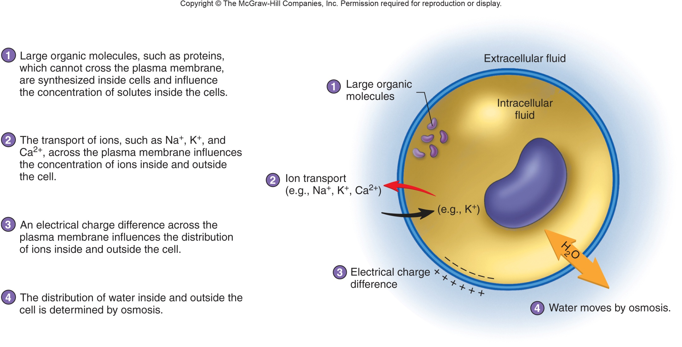
Regulation of Intracellular Fluid

Slide 13
Extracellular Fluid Osmolarity
Osmolarity
  Particles per 1L of solvent – temperature dependent (volume larger at higher temperature)
Increased osmolality: triggers thirst and ADH secretion
Decreased osmolality: inhibits thirst and ADH secretion
Notes:
Osmolarity = Particles per 1L of solvent – temperature dependent (volume larger at higher temperature) Measure Osmolality
Osmolality = Particles per 1kg of solvent – temperature independent. Calculate Osmolarity

Slide 14
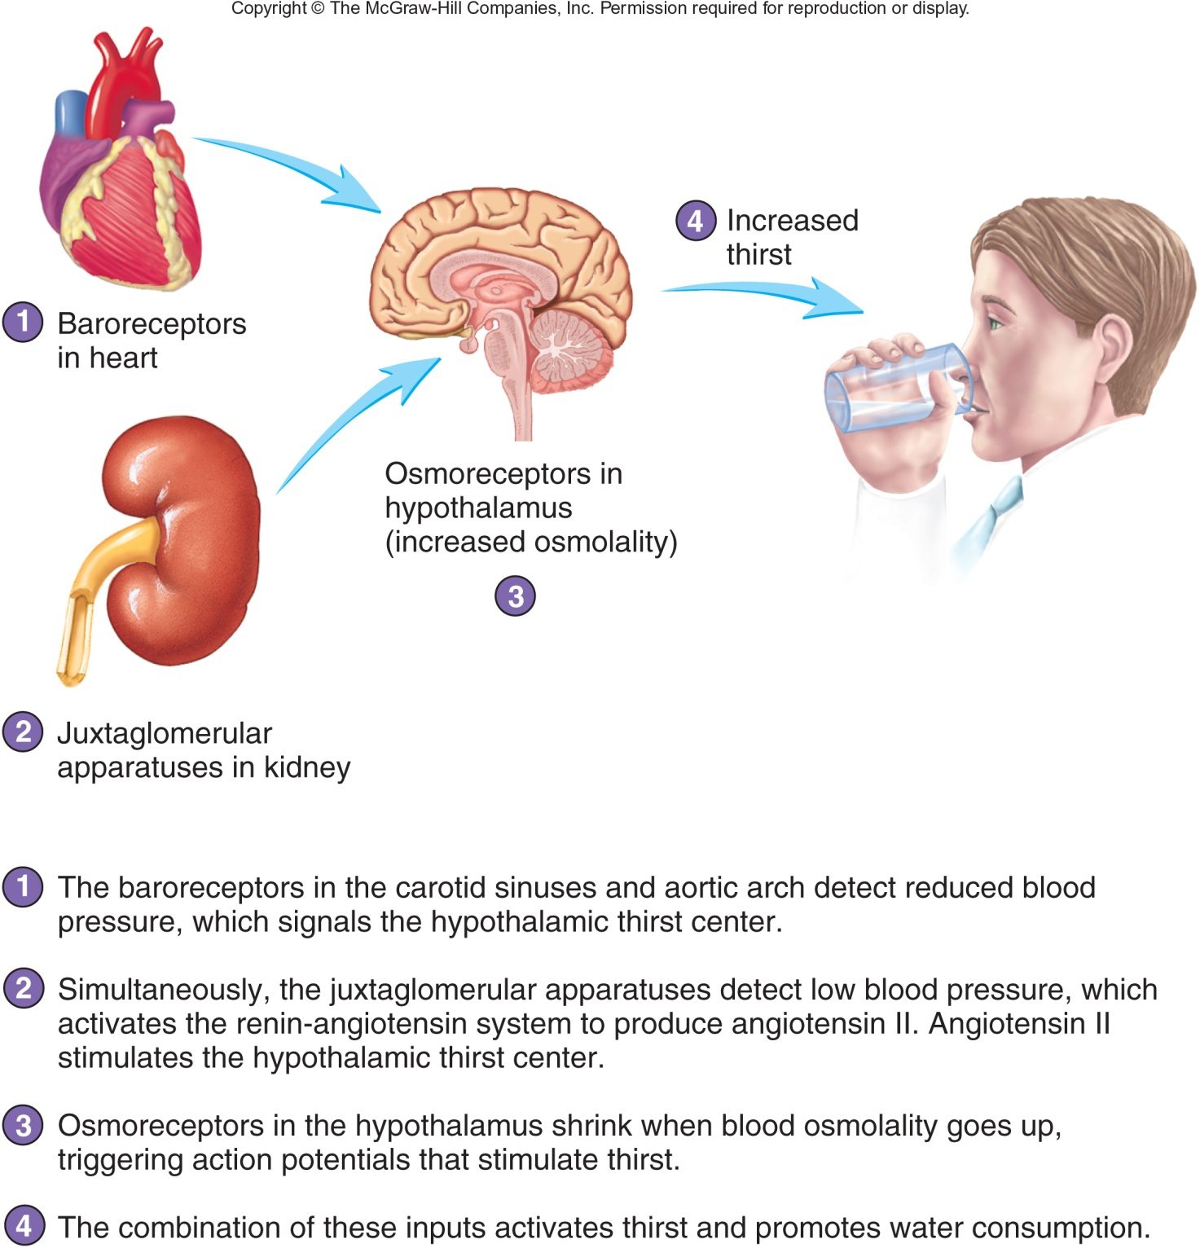
Effect of Blood Osmolality and Blood Pressure on Thirst

Slide 15
Regulation of Extracellular Fluid Osmolality
Electrolytes
  Molecules or ions with an electrical charge
    Ingestion adds electrolytes to body
    Kidneys, liver, skin, lungs remove from body
Sodium Ions (Na⁺)
  Dominant Extracellular Fluid cations
  Responsible for 90-95% of osmotic pressure
Regulation of Na⁺ ions
  Kidneys major route of excretion
  Small quantities lost in sweat {sweat = water, Na⁺, urea, Cl⁻K⁺, NH₃}.
Terms
  Hypernatremia: elevated plasma Na⁺
  Hyponatremia: decreased Na⁺

Slide 16
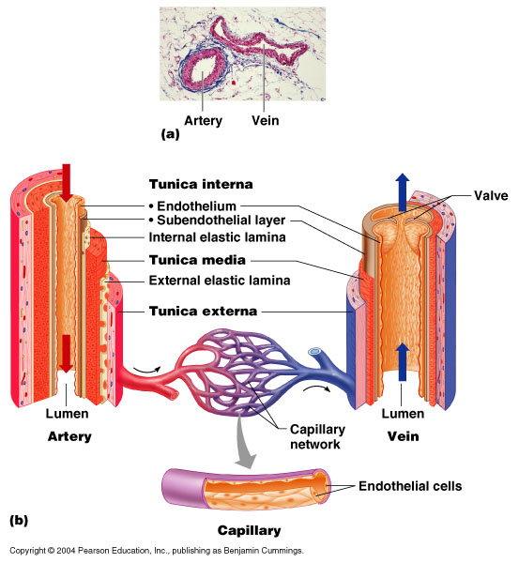
The structure of arteries, veins and capillaries: a) photomicrograph of an artery and vein in cross section b) diagrammatic view of an artery, a vein and a capillary

Slide 17
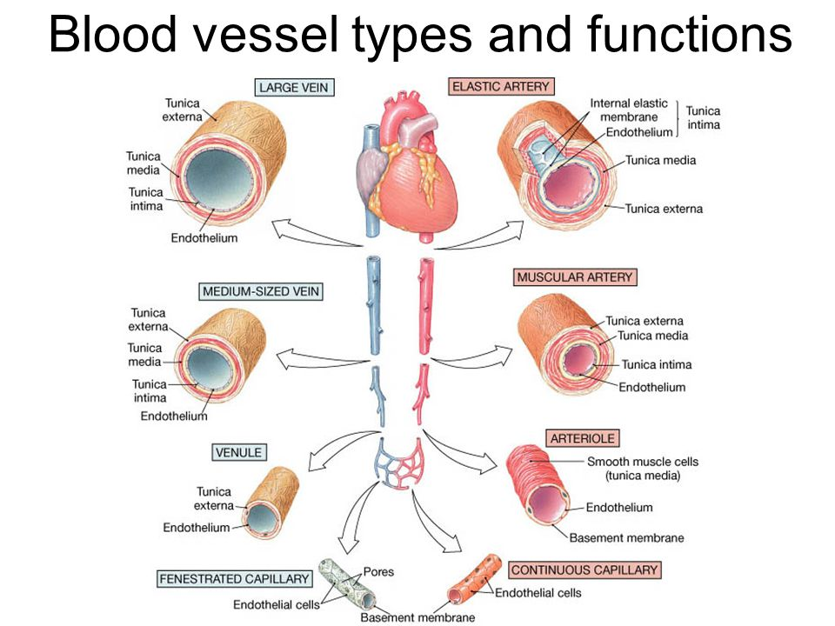
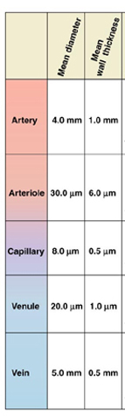

Slide 18
Capillaries
Capillary blood flow is slow and intermittent reflecting the need for an erythrocyte transit time of >1 second for complete O₂ diffusion from the capillary to surrounding tissue.
The erythrocyte has a diameter of 7.2μm, slowing its passage through the capillary due to their diameter exceeding the size of the capillary lumen (erythrocyte diameter = 3-20μm). The erythrocyte deforms enabling passage through the capillary loop, slowing the transit time and encouraging complete O₂ conductance.
Types: nutritional [unresponsive to thermal stress and do not increase blood flow in response to heat]capillaries & thermoregulatory capillaries
Under resting conditions skin may be over-perfused and available figures suggest that 0.8 ml of blood/min/100 ml would be adequate to supply the skin oxygen requirements at rest. However the mean and maximum skin blood flow is higher than this value. A considerable reserve capacity therefore exists which would enable flow to increase by a magnitude of 100 times the resting value during hyperaemia.
The number of capillaries per unit area is considered a determinant of tissue oxygenation

Slide 19
3. The structure of the heart

Slide 20
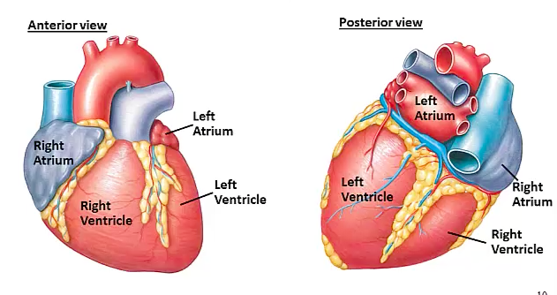
Surface Anatomy
Five surfaces:
Anterior (right ventricle)
Posterior (left atrium)
Inferior
Right pulmonary
Left pulmonary

Slide 21
Sulci of the Heart
Heart interior is divided into four chambers demarcated by grooves on the external surface (Sulci [plural]).
Coronary / atrioventricular sulcus is a transverse band around the heart separating atria & ventricles (contains the right coronary artery).
Anterior and Posterior interventricular sulci, vertically aligned bands on front and rear, separating the ventricles.

Slide 22
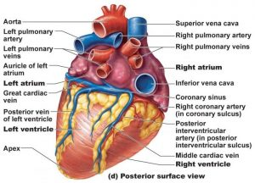
Sulci of the Heart

Slide 23
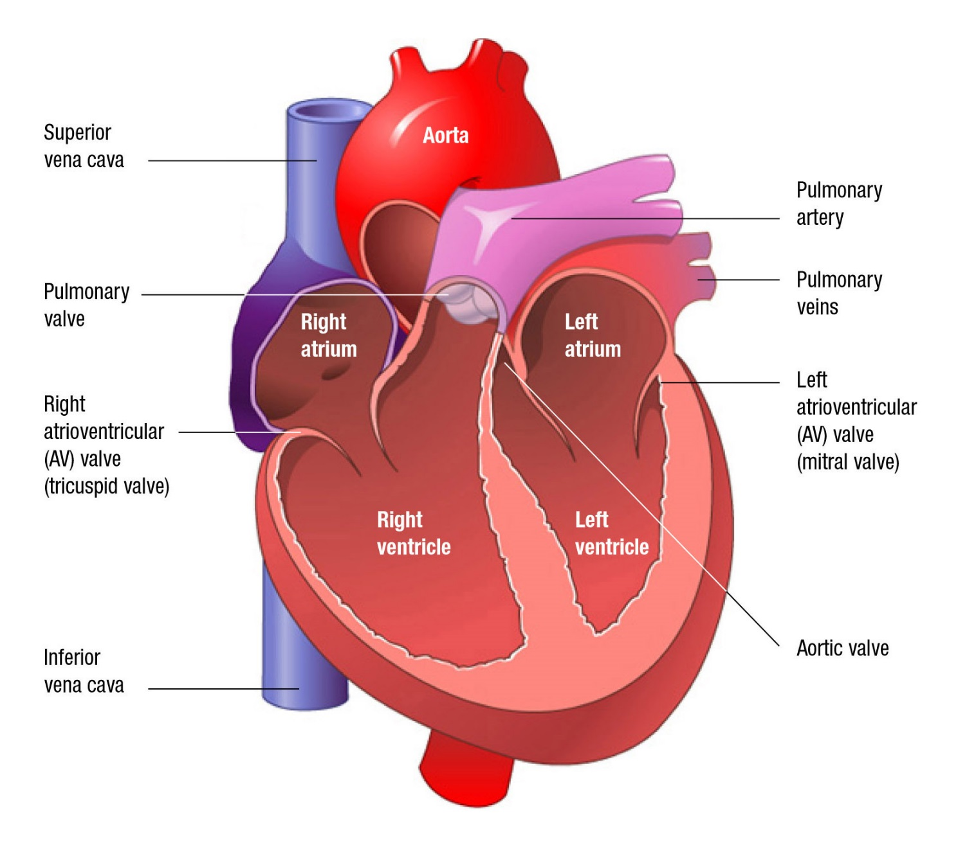
Basic Anatomy of the Heart

Slide 24
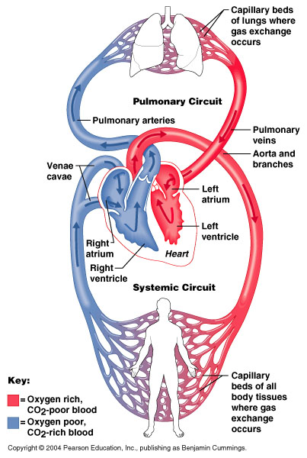
Atria of the Heart
Atria receive
Blood enters right atria from superior and inferior
venae cavae and coronary sinus
Blood enters left atria from pulmonary veins

Slide 25
Ventricles of the Heart
Ventricles discharge
Right ventricle pumps blood into the pulmonary trunk
Left ventricle pumps blood into the aorta

Slide 26
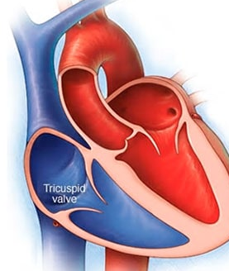
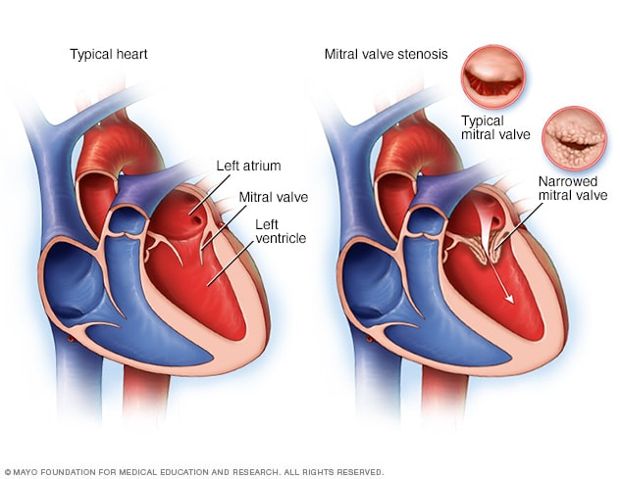
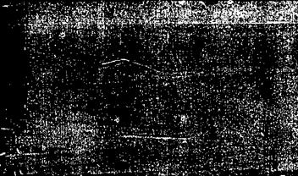
Two Atrioventricular valves
Tricuspid valve [right side] This valve is located between
the right atrium and the right ventricle.
Mitral (bicuspid) valve [left side] This valve is located between the left atrium and the left ventricle. It has only 2 leaflets.
Notes:
Tricuspid – blood flow to right ventricle
Mitral (atrioventricular) – prevents backflow during left ventricular ejection

Slide 27
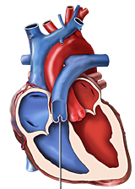
Two semilunar valves
Pulmonary valve. The pulmonary valve is located between the right ventricle
and the pulmonary artery.
Aortic valve. The aortic valve is located between the left ventricle and the aorta.
Notes:
Pulmonary – blood flow from right ventricle
Aortic – allows ejection from the left ventricle

Slide 28
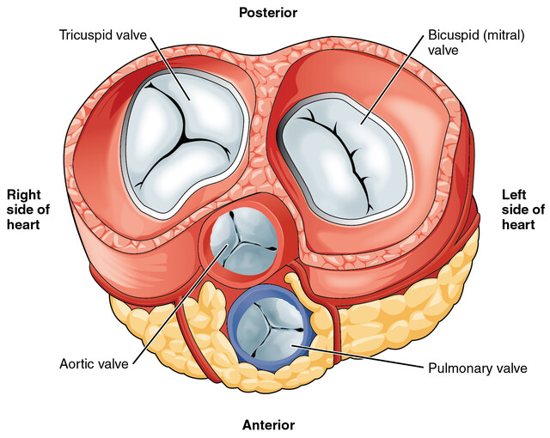

Slide 29
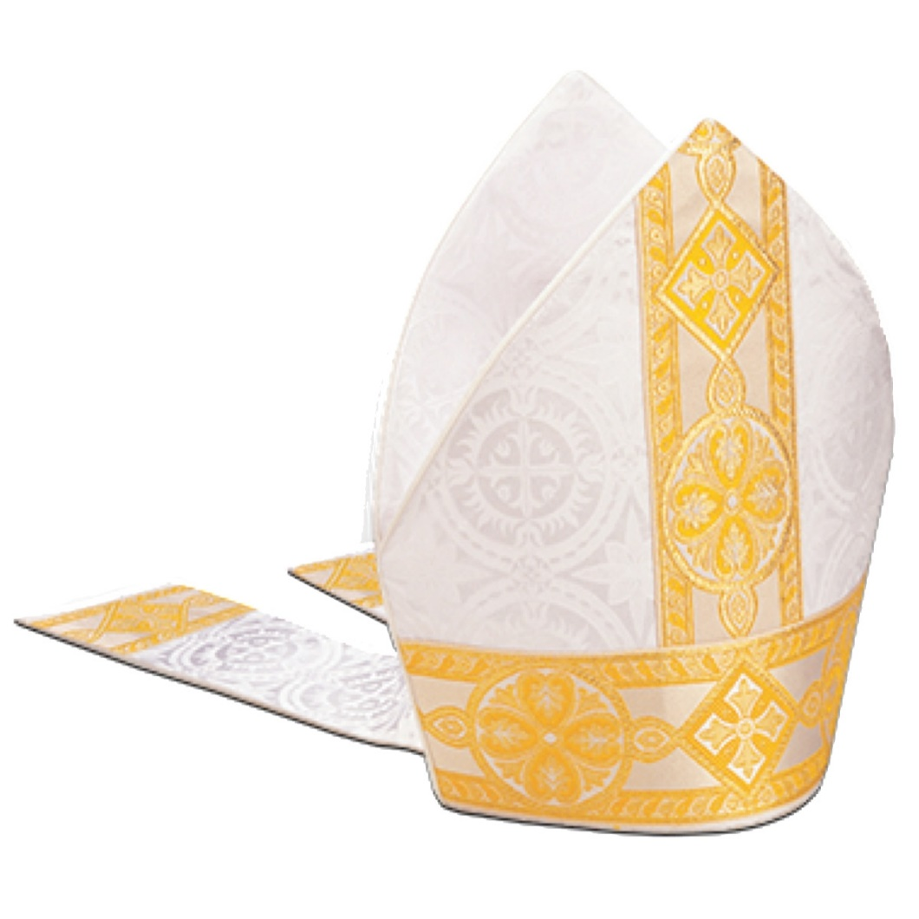
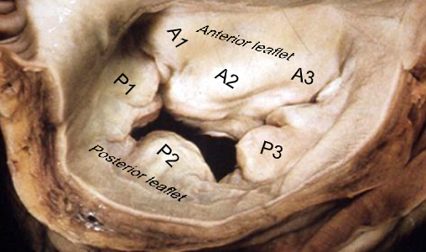
Mitral / Bicuspid valve

Slide 30
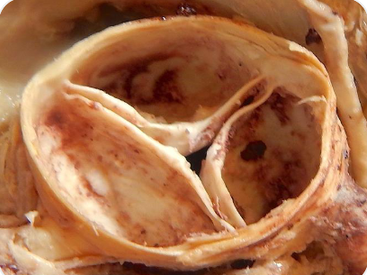
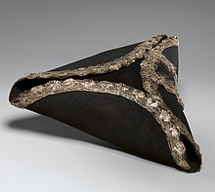
Tricuspid valve

Slide 31
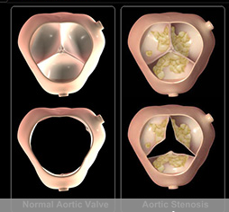
Aortic valve

Slide 32

Tricuspid valve. This valve is located between the right atrium and the right ventricle.
Pulmonary valve. The pulmonary valve is located between the right ventricle and the pulmonary artery.
Mitral valve. This valve is located between the left atrium and the left ventricle. It has only 2 leaflets.
Aortic valve. The aortic valve is located between the left ventricle and the aorta.
Notes:
Tricuspid – blood flow to right ventricle
Pulmonary – blood flow from right ventricle
Mitral (atrioventricular) – prevents backflow during left ventricular ejection
Aortic – allows ejection from the left ventricle

Slide 33
Heart layers
Notes:
Myo = muscle
Endo = within, inner
Epi = on, upon, against

Slide 34
Heart layers
Epicardium = visceral pericardium
Endocardium composed of connective tissues layers
Subendocardium lies between the myocardium and the endocardium and contains the conduction system.
Notes:
Pericardiectomy = increased maximal Q (29%), VO2max (31%). Increased left ventricular end-diastolic dimension (10%) and 33% increase in end-diastolic volume
https://doi.org/10.1152/ajpheart.1992.263.6.H1675

Slide 35
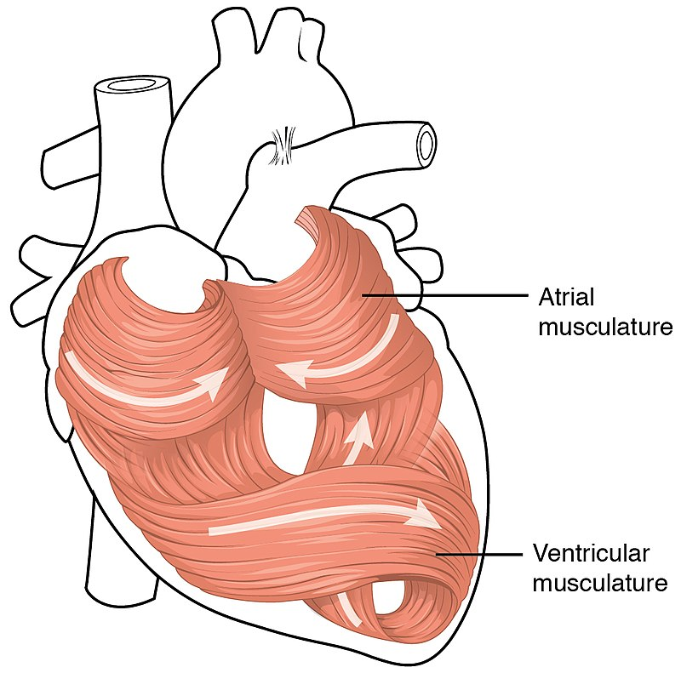
Arrangement of myocardial bundles in the heart.
Ventricular muscle is thick relative to the thinner Atrial muscle, allowing more forceful contraction.
Notes:
Cardiac muscle cells are roughly rectangular, measuring 100–150μm by 30–40μm – contrast skeletal muscle cells (hence called fibers) of 2–3 cm long and 100 μm in diameter.

Slide 36
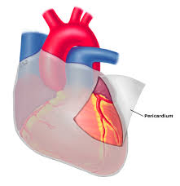
Pericardium
Double layered and fluid filled sack.
  Outer parietal pericardium
  Inner visceral pericardium
Role:
Impact reduction
Prevention of over expansion and fluid volume
Immuno-enhancing
Reduces friction via lubrication relative to adjacent tissues.
Notes:
Pericardiectomy = increased maximal Q (29%), VO2max (31%). Increased left ventricular end-diastolic dimension (10%) and 33% increase in end-diastolic volume
https://doi.org/10.1152/ajpheart.1992.263.6.H1675
250-350 gram heart normal pericardium volume [15-50 ml fluid], DOI: 10.1016/s1054-8807(99)00029-0

Slide 37
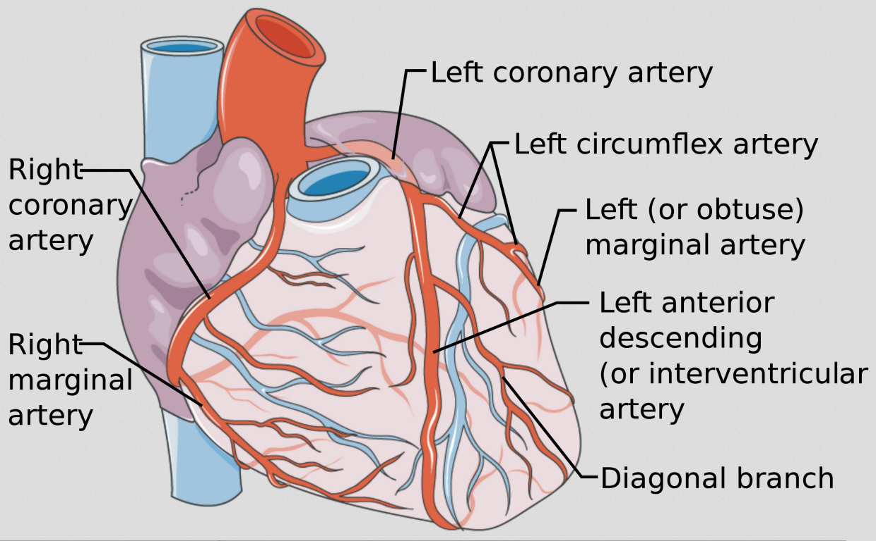
Coronary Circulation: Arterial Supply
Branching off the lower Aorta, these vessels supply the heart which has the highest oxygen requirement of any tissue.
Notes:
Branch off base of aorta
The resting coronary blood flow is ∼250 ml min⁻¹ (0.8 ml min⁻¹ g⁻¹ of heart muscle); this represents 5% of cardiac output – highest VO2 of any tissue in humans.
Arterial extraction at rest = 70-80% contrast 25% in all other tissues.

Slide 38
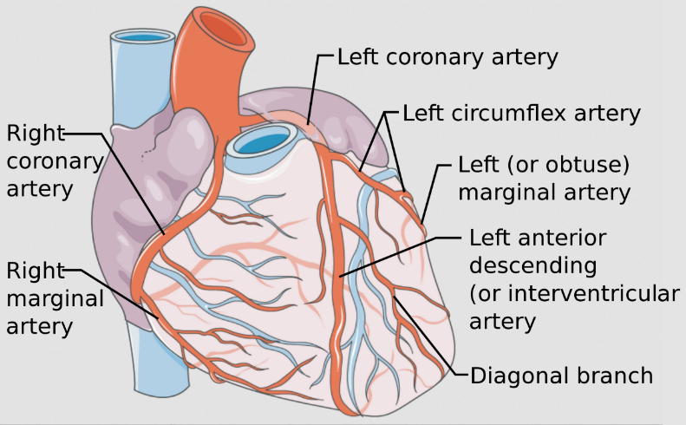
Coronary Circulation: Arterial Supply
Left and right coronary arteries
Circumflex artery – supplies posterior heart
Left anterior descending artery – supplies anterior heart
Smaller branches include: acute marginal, posterior descending, obtuse marginal and diagonals.
Notes:
Branch off base of aorta
The resting coronary blood flow is ∼250 ml min⁻¹ (0.8 ml min⁻¹ g⁻¹ of heart muscle); this represents 5% of cardiac output – highest VO2 of any tissue in humans.
Arterial extraction at rest = 70-80% contrast 25% in all other tissues.

Slide 39
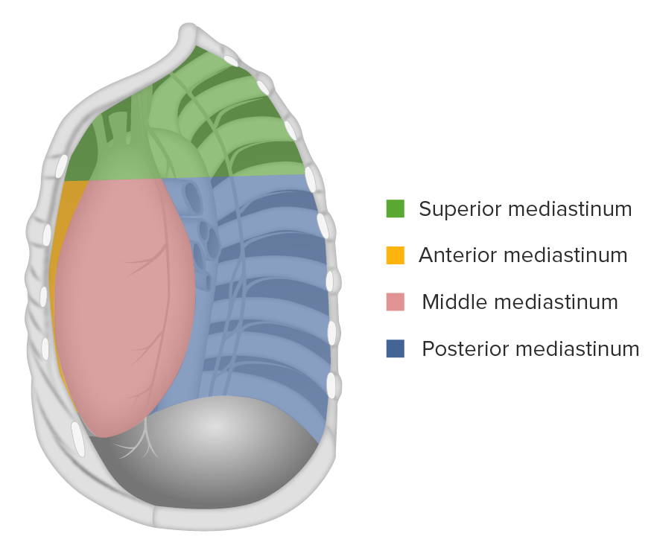
Mediastinum
Chest space holding heart and several significant structures
Located mid thoracic between left and right plural cavities
Notes:
houses vital structures - heart, great vessels, trachea, essential nerves.
Protected pathway for structures traversing from the neck, superiorly, and into the abdomen, inferiorly.

Slide 40
Mediastinum
Borders of each region:
1. Superior: bordered by the thoracic outlet superiorly, transverse thoracic plane or sternal angle inferiorly, medial border of the pleural sacs laterally, dorsal surface of the sternum anteriorly, and ventral surface of the first four thoracic vertebral bodies posteriorly.
Organs: thymus, trachea, eosophagus
Nerves: left and right vagus, recurrent laryngeal, cardiac, left and right phrenic

Slide 41
Mediastinum
2. Anterior: bordered by the pericardium posteriorly, medial border of the pleural sacs laterally, and the sternum, transversus thoracis muscles, and 5th, 6th and 7th left costal cartilages anteriorly.
Organs: thymus
Nerves: none

Slide 42
Mediastinum
3. Middle: formed by the borders of the pericardial sac anteriorly and posteriorly, reflected to the medial borders of the pleural sacs bilaterally, transverse thoracic plane superiorly, and thoracic surface of the diaphragm inferiorly
Organs: the heart and its great vessel roots, trachea and main bronchi
Nerves: phrenic, vagus, sympathetics

Slide 43
Mediastinum
4. Posterior: bordered by the pericardium anteriorly, the thoracic surface of the diaphragm inferiorly, transverse thoracic plane superiorly, 5th – 12th thoracic vertebral bodies posteriorly, and the pleural sacs laterally.
Organs: esophagus
Nerves: vagus, splanchnic, sympathetic chain

Slide 44
4. The Cardiac Cycle

Slide 45
Resting HR of 74 bpm
Cardiac cycle = 0.81sec (60÷74)
Diastole = .5 sec / 62%
Systole = .31 sec / 38%

Slide 46
Maximal HR of 185 bpm
Cardiac cycle = 0.32sec (60÷185)
Diastole = .19 sec / 62%
Systole = .12 sec / 38%

Slide 47
5. Myocardial action potential and contraction coupling

Slide 48
Cardiac Rhythm
Key words!
Depolarisation- Contraction, blood leaving, systole
Repolarisation- Relaxation, blood filling, diastole
There are two types of cells within the cardiac muscle:
Cardiomyocytes- Cells which make up the atria and the ventricles.
Autorhythmic cells - Specialised cardiac muscle cells, which are self-excitable (intrinsic).
Action potential – Spread from the autorhythmic cells and kick start the intrinsic conduction system
Notes:
Cardiomyocytes- Cells which make up the atria and the ventricles. A myocardial cell contains myofibrils, which are specialized organelles consisting of long chains of sarcomeres, the fundamental contractile units of muscle cells.
Autorhythmic cells - Specialised cardiac muscle cells, which are self-excitable (intrinsic). Therefore Autorhythmic cells repeatedly generate action potentials that trigger heart contractions, through the conduction nodes and pathways.
Action potentials – Spread from the autorhythmic cells within the intrinsic conduction system to the contractile cells are electrical events. Contracting the Cardiomyocytes causing a heartbeat.

Slide 49
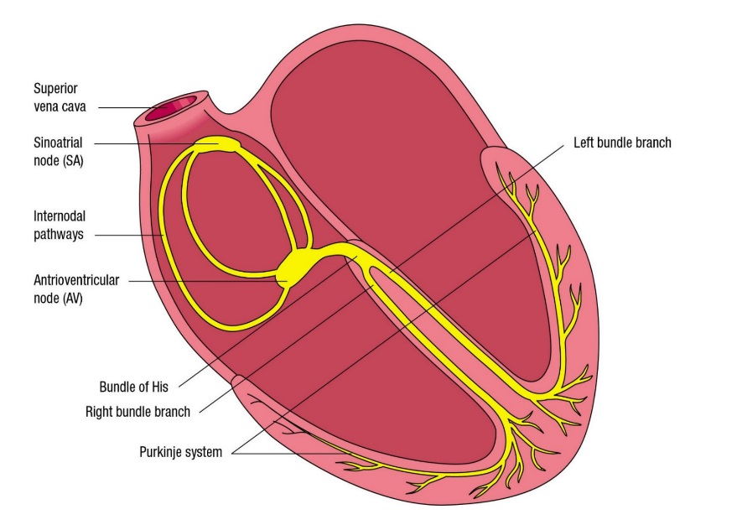
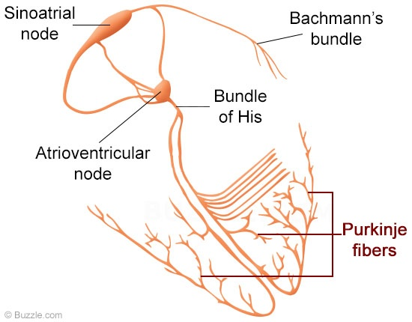
Conducting System of the Heart

Slide 50
Excitation – contraction coupling involves an ‘action potential’ activating contraction then relaxation of a cardiac myocyte.
In the heart, nervous activity is not responsible for the action potential – cardiac pacemaker cells located in the sinoatrial node of the right atrium initiate contraction.

